Slide 1


PUSL2024
Software Engineering 02
Plymouth Batch 11
Pramudya Thilakaratne pramudya.h@nsbm.ac.lk
Head of the Department
Department of Data Science
Faculty of Computing
NSBM Green University
Lecture 04

Slide 2
Java Encapsulation
Encapsulation is one of the key features of object-oriented programming.
Encapsulation refers to the bundling of fields and methods inside a single class.
It prevents outer class from accessing and changing fields and methods of a class.
This also helps to achieve data hiding.
Data hiding is a way of restricting the access of our data members by hiding the implementation details.

Slide 3
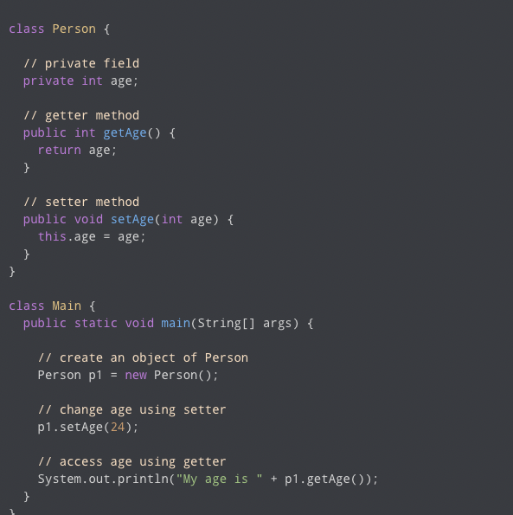
Data Hiding Using the Private Specifier

Slide 4
Data Hiding Using the Private Specifier
In above example, there is a private field called age. Since it is private, it cannot be accessed from outside the class.
In order to access age, we use public methods: getAge( ) and setAge( ). These methods are called getter and setter methods.
Making age private allowed us to restrict unauthorized access from outside the class. This is data hiding.

Slide 5
Task 01
Read the following instructions and create the console application program
Create a class called EncapData.java and create two private variables to store radius value and pi value.
Inside the main class you have to get the radius value from the user and pass it to EncapData.java Class.
Inside EncapData.java class create getters and setters to find the Area of the circle and to find the circumference of the circle.
Return the answers from the EncapData.java Class
Display the answers inside Main class.

Slide 6
Java Inheritance
Inheritance is one of the key features of OOP that allows us to create a new class from an existing class.
The new class that is created is know as subclass (child or derived class) and the existing class from where the child class is derived is known as superclass (parent or base class).
The extends keyword is used to perform inheritance in Java.

Slide 7
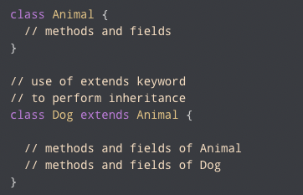
Java Inheritance
Syntax

Slide 8
Java Inheritance
In the above example, the Dog class is created by inheriting the methods and fields from the Animal class.
Here, Dog is the subclass and Animal is the superclass.

Slide 9
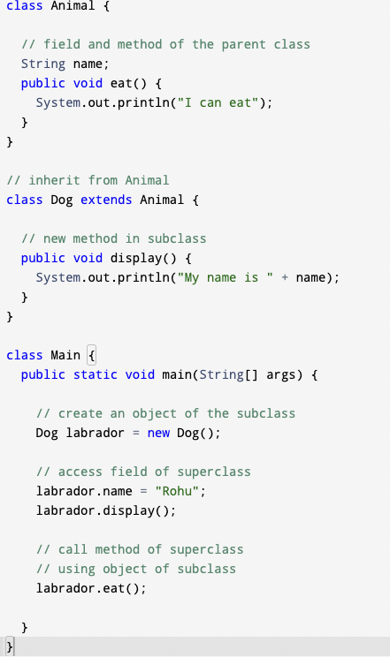
Java Inheritance Example

Slide 10
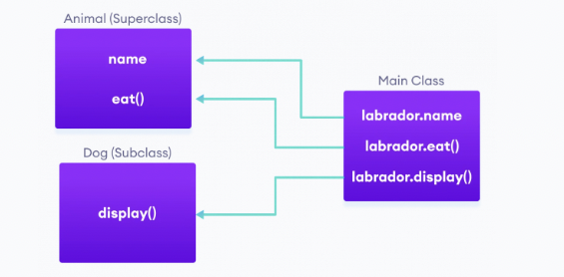
Java Inheritance
In the above example, we have derived a subclass Dog from superclass Animal.
Since Dog inherits the fields and methods from Animal, we are able to access the fields and method using the object of the Dog.

Slide 11
Java Inheritance
is – a relationship
In Java, inheritance is an is-a relationship. That is, we use inheritance only if there exists an is-a relationship between two classes. For example,
Car is a Vehicle
Orange is a Fruit
Surgeon is a Doctor

Slide 12
Task 02
Create a Console application with two added classes called “Animal” and “Cat”.
‘Cat’ is the derived class (Child) of ‘Animal Class’ (Base Class).
Inside the ‘Animal Class’ Create a method.
Inside the method print “I am an Animal”.
Inside the “Cat Class” Create a method and display “I have four legs”.
Inside the main method create relevant class object and Display as follows.
“I am an animal I have four legs”.

Slide 13

Break Time Resume at – 10.45am

